Slide 1
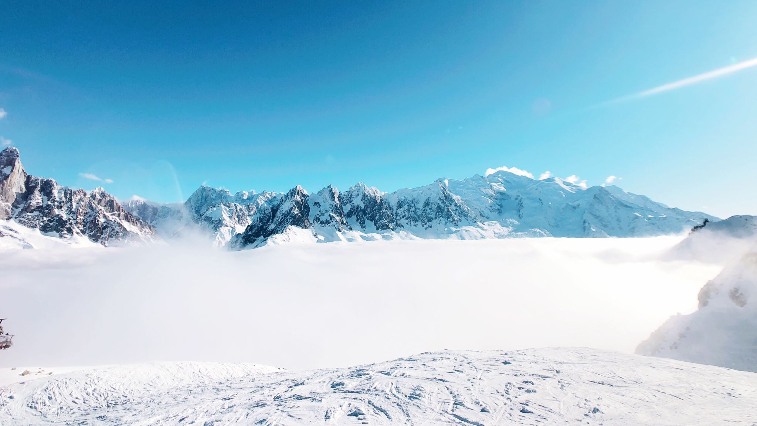
Big Mountain Ski Resort: Optimizing Revenue and Operations

Slide 2
Introduction
The installation of new chair lift has increased the operation cost by $ 1,540,000 this year.
The Resort’s Pricing Strategy is generic and does not exploit all the different facilities it offers.
To Stay Relevant in Market, we either need to Increase revenue and/or reduce Operation Costs while maintaining the resort's features

Slide 3
Dataset
Location
Facilities
Pricing
The dataset includes information about various resorts in the United States regarding:

Slide 4
EDA & Findings
There is a strong correlation between Ticket Pricing and several key features of the resort.
Four features in particular stood out as having a significant impact on ticket pricing: FastQuads, SnowMaking_ac, Runs, and Night skiing ratio.
The Resort ranks in Top Quartile in seven of the 8 most important qualities namely Total Area of snow makers, Vertical Drop, Total chairs, Total Number of Runs, fastQuads, Longest Run and Skiable Terrain Area.

Slide 5
Random Forest Model
Explanation of the Random Forest Model and its prediction of the optimal ticket price at $89
Justification of the chosen price based on the model's insights and features

Slide 6

Resort Optimization Analysis
Three main areas for optimization: ticket price justification, operation cost reduction, and maintaining competitiveness
Insight: The resort can close up to 6 runs per day without impacting revenue
Explanation of how reducing runs can lead to cost savings without sacrificing revenue
Big Mountain's ranking in top quartile for key qualities, emphasizing its strong market position
Identification of qualities where the resort excels compared to competitors

Slide 7
Ticket Price Justification
Analysis of features that can justify the ticket price increase to $89
Details on adjustments that can be made to facilities to support the price increase

Slide 8
Facility Improvement Recommendations
Suggested improvements: Lowering a run by 150 ft, installing an additional chair lift, adding one run, and increasing snow area by
Explanation of how these improvements lead to a $3.39 increase in ticket price and $5,930,556 in revenue

Slide 9
Maintaining Competitiveness
Assurance that the resort's features and position will remain intact after implementing the price increase and facility improvements
Importance of staying relevant and appealing to visitors

Slide 10
Implementation Plan
Timeline for implementing the recommended changes
Coordination with different departments for smooth execution

Slide 11
Monitoring and Feedback
Importance of continuous monitoring of revenue and visitor feedback
Flexibility in adjusting strategies based on market response

Slide 12
Conclusion
Recap of the main findings and recommendations
Emphasis on the potential impact of the strategies on Big Mountain's revenue and competitiveness

Slide 13

Q&A
Open the floor for questions and discussions

